Slide 1

Analytics, Data Science and A I: Systems for Decision Support
Eleventh Edition
Chapter 4
Data Mining Process, Methods, and Algorithms
Slide in this Presentation Contain Hyperlinks. JAWS users should be able to get a list of links by using INSERT+F7
Copyright © 2020, 2015, 2011 Pearson Education, Inc. All Rights Reserved
Notes:
If this PowerPoint presentation contains mathematical equations, you may need to check that your computer has the following installed:
1) Math Type Plugin
2) Math Player (free versions available)
3) NVDA Reader (free versions available)

Slide 2
Learning Objectives (1 of 2)
4.1 Define data mining as an enabling technology for business analytics
4.2 Understand the objectives and benefits of data mining
4.3 Become familiar with the wide range of applications of data mining
4.4 Learn the standardized data mining processes
4.5 Learn different methods and algorithms of data mining
Notes:
Slide 2 is list of textbook LO numbers and statements

Slide 3
Learning Objectives (2 of 2)
4.6 Build awareness of the existing data mining software tools
4.7 Understand the privacy issues, pitfalls, and myths of data mining
Notes:
Slide 2 is list of textbook LO numbers and statements

Slide 4
Opening Vignette (1 of 3)
Miami-Dade Police Department Is Using Predictive Analytics to Foresee and Fight Crime
Predictive analytics in law enforcement
Policing with less
New thinking on cold cases
The big picture starts small
Success brings credibility
Just for the facts
Safer streets for smarter cities

Slide 5
Opening Vignette (2 of 3)
Miami-Dade Police Department Is Using Predictive Analytics to Foresee and Fight Crime
Discussion Questions
Why do law enforcement agencies and departments like Miami-Dade Police Department embrace advanced analytics and data mining?
What are the top challenges for law enforcement agencies and departments like Miami-Dade Police Department? Can you think of other challenges (not mentioned in this case) that can benefit from data mining?

Slide 6
Opening Vignette (3 of 3)
Miami-Dade Police Department Is Using Predictive Analytics to Foresee and Fight Crime
Discussion Questions (continued)
What are the sources of data that law enforcement agencies and departments like Miami-Dade Police Department use for their predictive modeling and data mining projects?
What type of analytics do law enforcement agencies and departments like Miami-Dade Police Department use to fight crime?
What does “the big picture starts small” mean in this case? Explain.

Slide 7
Data Mining Concepts and Definitions Why Data Mining?
More intense competition at the global scale.
Recognition of the value in data sources.
Availability of quality data on customers, vendors, transactions, Web, etc.
Consolidation and integration of data repositories into data warehouses.
The exponential increase in data processing and storage capabilities; and decrease in cost.
Movement toward conversion of information resources into nonphysical form.

Slide 8
Definition of Data Mining
The nontrivial process of identifying valid, novel, potentially useful, and ultimately understandable patterns in data stored in structured databases. -- Fayyad et al., (1996)
Keywords in this definition: Process, nontrivial, valid, novel, potentially useful, understandable.
Data mining: a misnomer?
Other names: knowledge extraction, pattern analysis, knowledge discovery, information harvesting, pattern searching, data dredging,…

Slide 9
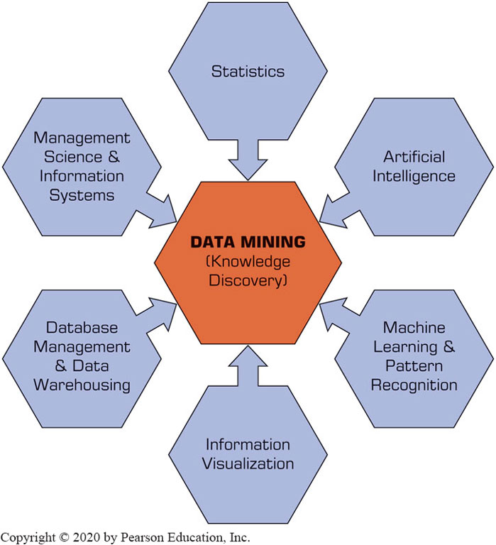
Data Mining Is a Blend of Multiple Disciplines
Figure 4.1 Data Mining Is a Blend of Multiple Disciplines.

Slide 10
Application Case 4.1
Visa Is Enhancing the Customer Experience While Reducing Fraud with Predictive Analytics and Data Mining
Questions for Discussion:
What challenges were Visa and the rest of the credit card industry facing?
How did Visa improve customer service while also improving retention of fraud?
What is in-memory analytics, and why was it necessary?

Slide 11
Data Mining Characteristics & Objectives
Source of data for D M is often a consolidated data warehouse (not always!).
D M environment is usually a client-server or a Web-based information systems architecture.
Data is the most critical ingredient for D M which may include soft/unstructured data.
The miner is often an end user
Striking it rich requires creative thinking
Data mining tools’ capabilities and ease of use are essential (Web, parallel processing, etc.)

Slide 12
How Data Mining Works
D M extract patterns from data
Pattern? A mathematical (numeric and/or symbolic) relationship among data items
Types of patterns
Association
Prediction
Cluster (segmentation)
Sequential (or time series) relationships

Slide 13
Application Case 4.2
American Honda Uses Advanced Analytics to Improve Warranty Claims
Questions for Discussion:
How does American Honda use analytics to improve warranty claims?
In addition to warranty claims, for what other purposes does American Honda use advanced analytics methods?
Can you think of other uses of advanced analytics in the automotive industry? You can search the Web to find some answers to this question.

Slide 14
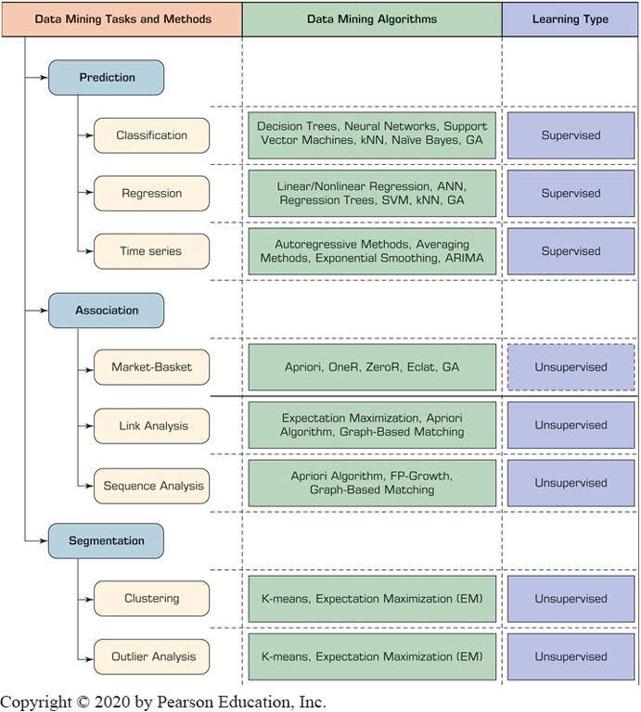
A Taxonomy for Data Mining
Figure 4.2 A Simple Taxonomy for Data Mining Tasks, Methods, and Algorithms.

Slide 15
Other Data Mining Patterns/Tasks
Time-series forecasting
Part of the sequence or link analysis?
Visualization
Another data mining task?
Covered in Chapter 3
Data Mining versus Statistics
Are they the same?
What is the relationship between the two?

Slide 16
Data Mining Applications (1 of 4)
Customer Relationship Management
Maximize return on marketing campaigns
Improve customer retention (churn analysis)
Maximize customer value (cross-, up-selling)
Identify and treat most valued customers
Banking & Other Financial
Automate the loan application process
Detecting fraudulent transactions
Maximize customer value (cross-, up-selling)
Optimizing cash reserves with forecasting

Slide 17
Data Mining Applications (2 of 4)
Retailing and Logistics
Optimize inventory levels at different locations
Improve the store layout and sales promotions
Optimize logistics by predicting seasonal effects
Minimize losses due to limited shelf life
Manufacturing and Maintenance
Predict/prevent machinery failures
Identify anomalies in production systems to optimize the use manufacturing capacity
Discover novel patterns to improve product quality

Slide 18
Data Mining Applications (3 of 4)
Brokerage and Securities Trading
Predict changes on certain bond prices
Forecast the direction of stock fluctuations
Assess the effect of events on market movements
Identify and prevent fraudulent activities in trading
Insurance
Forecast claim costs for better business planning
Determine optimal rate plans
Optimize marketing to specific customers
Identify and prevent fraudulent claim activities

Slide 19
Data Mining Applications (4 of 4)
Computer hardware and software
Science and engineering
Government and defense
Homeland security and law enforcement
Travel, entertainment, sports
Healthcare and medicine
Sports,… virtually everywhere…

Slide 20
Application Case 4.3
Predictive Analytic and Data Mining Help Stop Terrorist Funding
Questions for Discussion:
How can data mining be used to fight terrorism? Comment on what else can be done beyond what is covered in this short application case.
Do you think data mining, although essential for fighting terrorist cells, also jeopardizes individuals’ rights of privacy?

Slide 21
Data Mining Process
A manifestation of the best practices
A systematic way to conduct D M projects
Moving from Art to Science for D M project
Everybody has a different version
Most common standard processes:
C R I S P-D M (Cross-Industry Standard Process for Data Mining)
S E M M A (Sample, Explore, Modify, Model, and Assess)
K D D (Knowledge Discovery in Databases)

Slide 22
Data Mining Process: C R I S P-D M (1 of 2)
Cross Industry Standard Process for Data Mining
Proposed in 1990s by a European consortium
Composed of six consecutive phases
Step 1: Business Understanding
Step 2: Data Understanding
Step 3: Data Preparation
Step 4: Model Building
Step 5: Testing and Evaluation
Step 6: Deployment

Slide 23
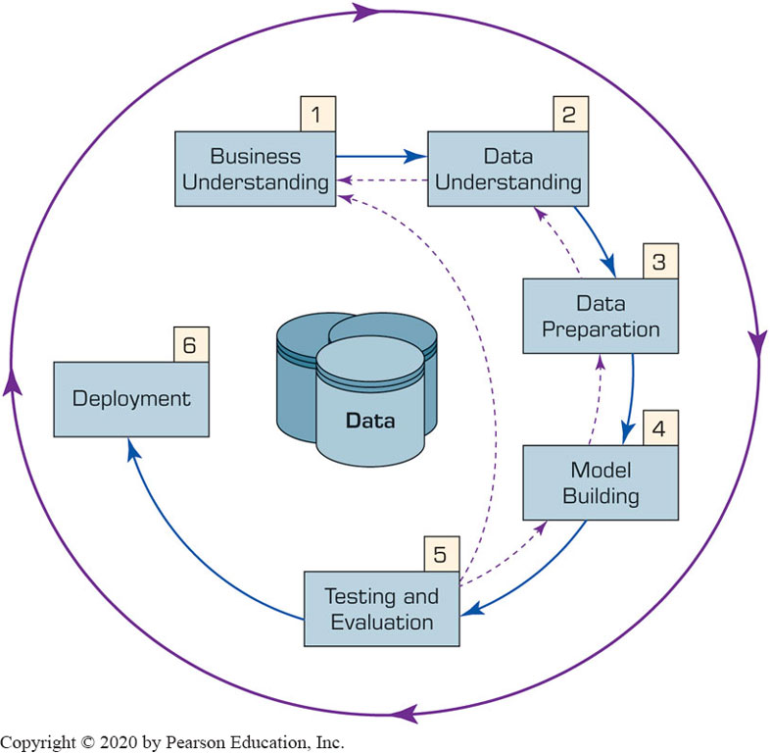
Data Mining Process: C R I S P-D M (2 of 2)
Figure 4.3 The Six-Step C R I S P-D M Data Mining Process. →
The process is highly repetitive and experimental (D M: art versus science?)

Slide 24
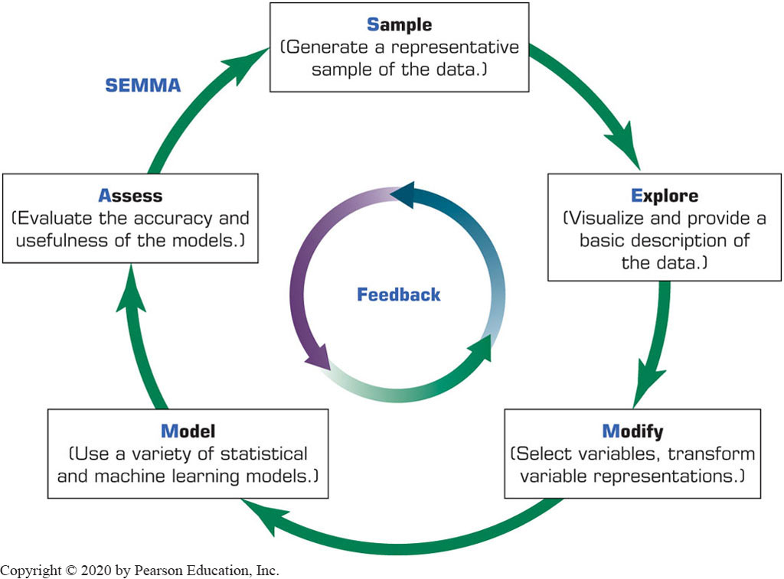
Data Mining Process: S E M M A
Figure 4.5 S E M M A Data Mining Process.
Developed by S A S Institute

Slide 25
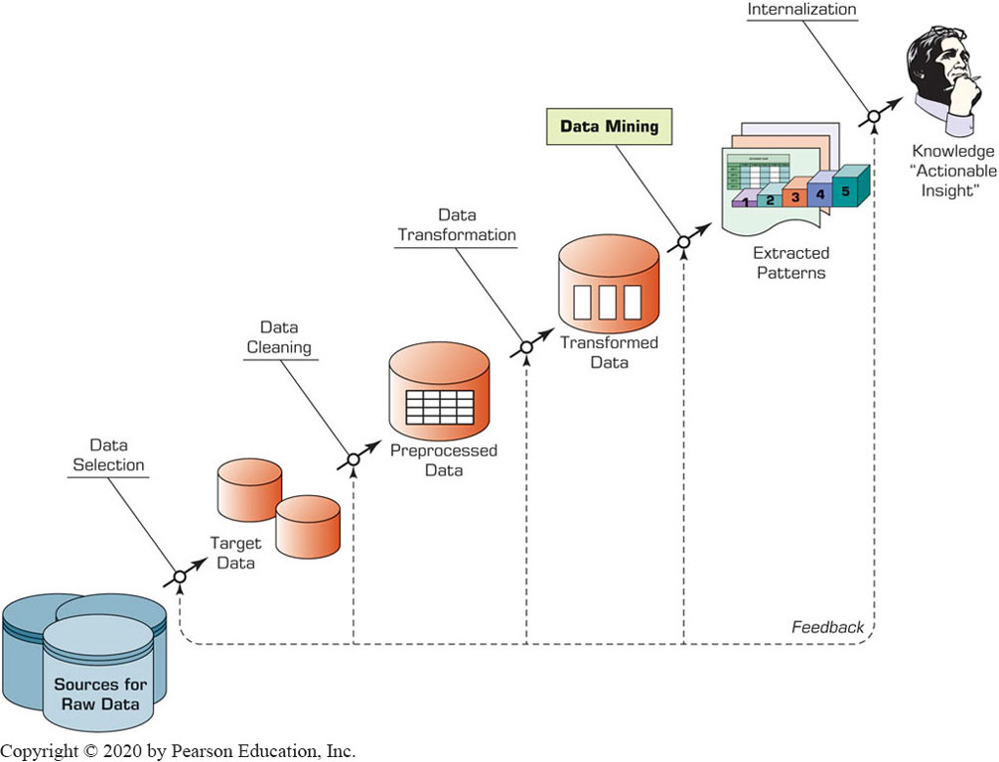
Data Mining Process: K D D
Figure 4.6 K D D (Knowledge Discovery in Databases) Process.

Slide 26
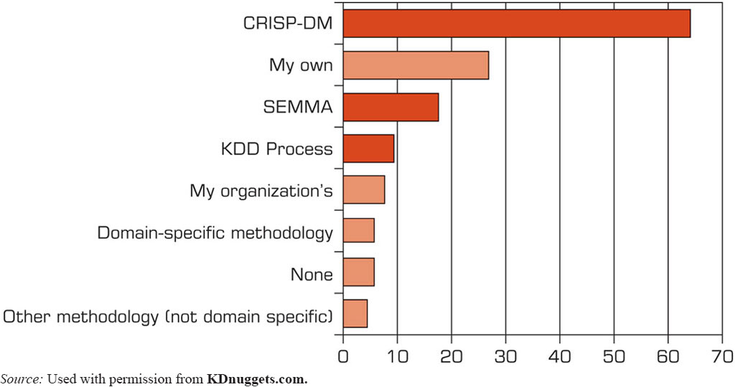
Which Data Mining Process is the Best?
Figure 4.7 Ranking of Data Mining Methodologies/Processes.
Source: Used with permission from KDnuggets.com.

Slide 27
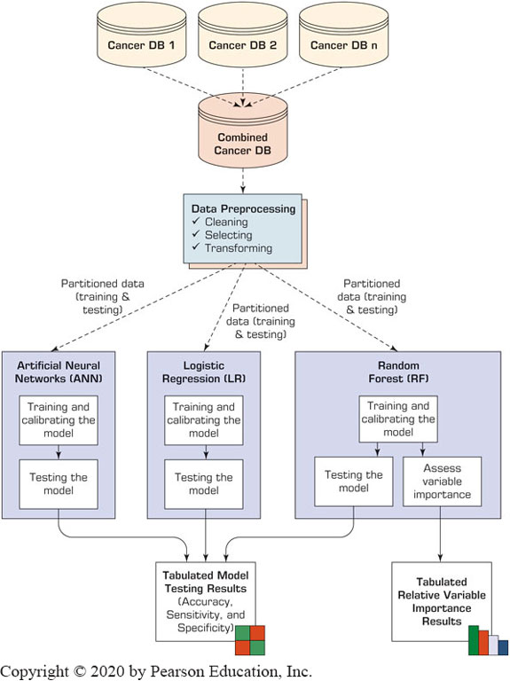
Application Case 4.4
Data Mining Helps in Cancer Research
Questions for Discussion
How can data mining be used for ultimately curing illnesses like cancer?
What do you think are the promises and major challenges for data miners in contributing to medical and biological research endeavors?

Slide 28
Data Mining Methods: Classification
Most frequently used D M method
Part of the machine-learning family
Employ supervised learning
Learn from past data, classify new data
The output variable is categorical (nominal or ordinal) in nature
Classification versus regression?
Classification versus clustering?

Slide 29
Assessment Methods for Classification
Predictive accuracy
Hit rate
Speed
Model building versus predicting/usage speed
Robustness
Scalability
Interpretability
Transparency, explainability

Slide 30
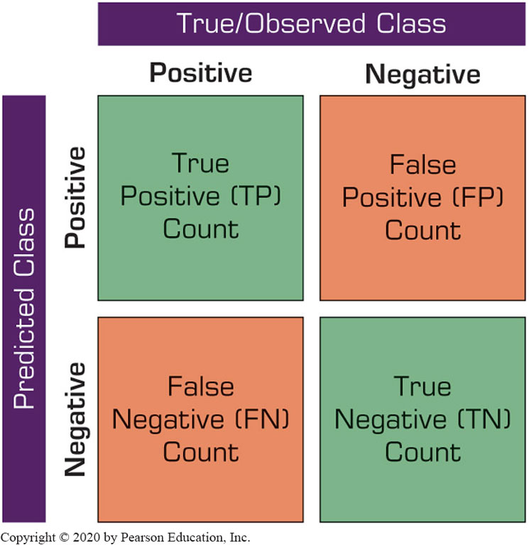
Accuracy of Classification Models
In classification problems, the primary source for accuracy estimation is the confusion matrix

Slide 31
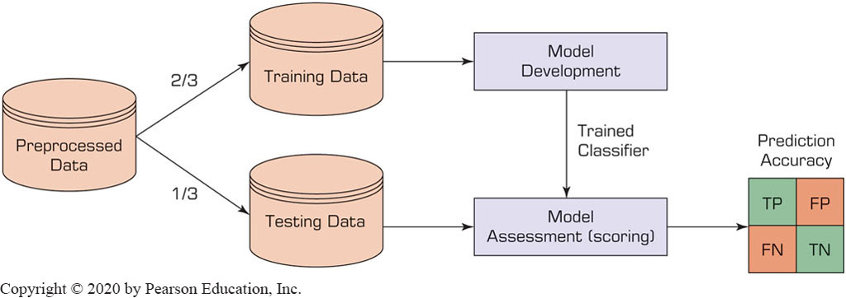
Estimation Methodologies for Classification: Single/Simple Split
Simple split (or holdout or test sample estimation)
Split the data into 2 mutually exclusive sets: training (~70%) and testing (30%)
For Neural Networks, the data is split into three sub-sets (training [~60%], validation [~20%], testing [~20%])

Slide 32
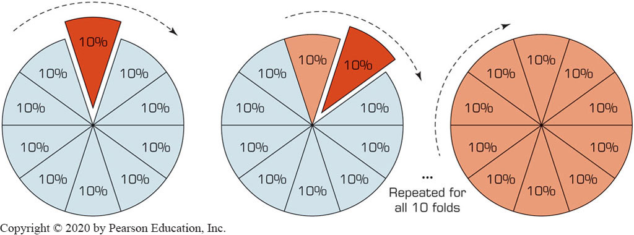
Estimation Methodologies for Classification: k-Fold Cross Validation
Data is split into k mutual subsets and k number training/testing experiments are conducted
Figure 4.10 A Graphical Depiction of k-Fold Cross-Validation.

Slide 33
Additional Estimation Methodologies for Classification
Leave-one-out
Similar to k-fold where k = number of samples
Bootstrapping
Random sampling with replacement
Jackknifing
Similar to leave-one-out
Area Under the R O C Curve (A U C)
R O C: receiver operating characteristics (a term borrowed from radar image processing)

Slide 34
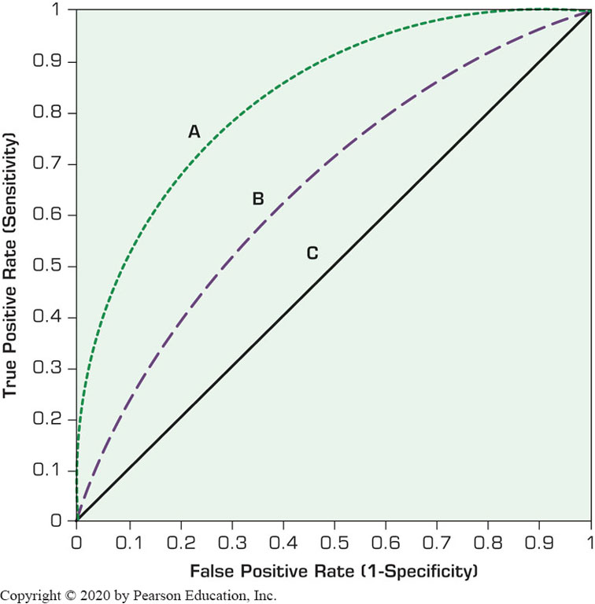
Area Under the R O C Curve (A U C) (1 of 2)
Works with binary classification
Figure 4.11 A Sample R O C Curve.

Slide 35
Area Under the R O C Curve (A U C) (2 of 2)
Produces values from 0 to 1.0
Random chance is 0.5 and perfect classification is 1.0
Produces good a assessment for skewed class distributions too!

Slide 36
Classification Techniques
Decision tree analysis
Statistical analysis
Neural networks
Support vector machines
Case-based reasoning
Bayesian classifiers
Genetic algorithms
Rough sets

Slide 37
Decision Trees (1 of 3)
Employs a divide-and-conquer method
Recursively divides a training set until each division consists of examples from one class:
Create a root node and assign all of the training data to it.
Select the best splitting attribute.
Add a branch to the root node for each value of the split. Split the data into mutually exclusive subsets along the lines of the specific split.
Repeat the steps 2 and 3 for each and every leaf node until the stopping criteria is reached.

Slide 38
Decision Trees (2 of 3)
Employs a divide-and-conquer method
Recursively divides a training set until each division consists of examples from one class:
A general algorithm (steps) for building a decision tree
Create a root node and assign all of the training data to it.
Select the best splitting attribute.
Add a branch to the root node for each value of the split. Split the data into mutually exclusive subsets along the lines of the specific split.
Repeat the steps 2 and 3 for each and every leaf node until the stopping criteria is reached.

Slide 39
Decision Trees (3 of 3)
D T algorithms mainly differ on
Splitting criteria
Which variable, what value, etc.
Stopping criteria
When to stop building the tree
Pruning (generalization method)
Pre-pruning versus post-pruning
Most popular D T algorithms include
I D3, C4.5, C5; C A R T; C H A I D; M5

Slide 40
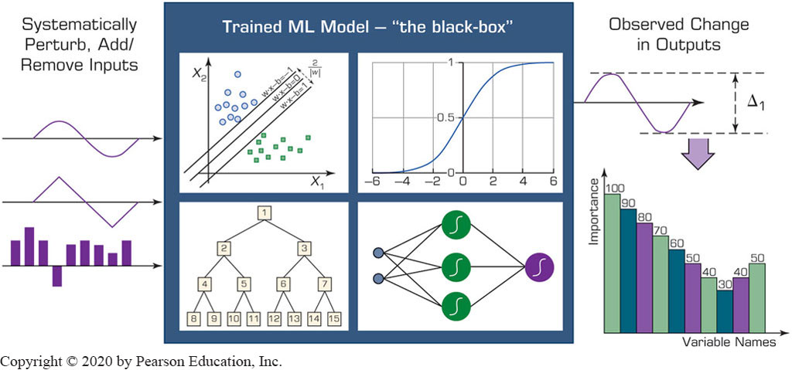
Ensemble Models for Predictive Analytics
Produces more robust and reliable prediction models
Figure 4.12 Graphical Illustration of a Heterogeneous Ensemble.

Slide 41
Application Case 4.5
Influence Health Uses Advanced Predictive Analytics to Focus on the Factors That Really Influence People’s Healthcare Decisions
Questions for Discussion:
What did Influence Health do?
What were the challenges, the proposed solutions, and the obtained results?
How can data mining help companies in the healthcare industry (in ways other than the ones mentioned in this case)?

Slide 42
Cluster Analysis for Data Mining (1 of 4)
Used for automatic identification of natural groupings of things
Part of the machine-learning family
Employ unsupervised learning
Learns the clusters of things from past data, then assigns new instances
There is not an output/target variable
In marketing, it is also known as segmentation

Slide 43
Cluster Analysis for Data Mining (2 of 4)
Clustering results may be used to
Identify natural groupings of customers
Identify rules for assigning new cases to classes for targeting/diagnostic purposes
Provide characterization, definition, labeling of populations
Decrease the size and complexity of problems for other data mining methods
Identify outliers in a specific domain (e.g., rare-event detection)

Slide 44
Cluster Analysis for Data Mining (3 of 4)
Analysis methods
Statistical methods (including both hierarchical and nonhierarchical), such as k-means, k-modes, and so on.
Neural networks (adaptive resonance theory [A R T], self-organizing map [S O M])
Fuzzy logic (e.g., fuzzy c-means algorithm)
Genetic algorithms
How many clusters?

Slide 45
Cluster Analysis for Data Mining (4 of 4)
k-Means Clustering Algorithm
k: pre-determined number of clusters
Algorithm (Step 0: determine value of k)
Step 1: Randomly generate k random points as initial cluster centers.
Step 2: Assign each point to the nearest cluster center.
Step 3: Re-compute the new cluster centers.
Repetition step: Repeat steps 3 and 4 until some convergence criterion is met (usually that the assignment of points to clusters becomes stable).

Slide 46
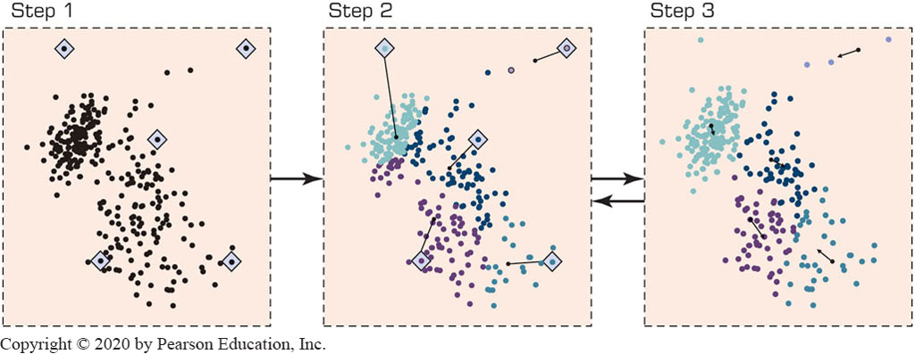
Cluster Analysis for Data Mining - k-Means Clustering Algorithm
Figure 4.13 A Graphical Illustration of the Steps in the k-Means Algorithm.

Slide 47
Association Rule Mining (1 of 6)
A very popular D M method in business
Finds interesting relationships (affinities) between variables (items or events)
Part of machine learning family
Employs unsupervised learning
There is no output variable
Also known as market basket analysis
Often used as an example to describe D M to ordinary people, such as the famous “relationship between diapers and beers!”

Slide 48
Association Rule Mining (2 of 6)
Input: the simple point-of-sale transaction data
Output: Most frequent affinities among items
Example: according to the transaction data…
“Customer who bought a lap-top computer and a virus protection software, also bought extended service plan 70 percent of the time."
How do you use such a pattern/knowledge?
Put the items next to each other
Promote the items as a package
Place items far apart from each other!

Slide 49
Association Rule Mining (3 of 6)
A representative applications of association rule mining include
In business: cross-marketing, cross-selling, store design, catalog design, e-commerce site design, optimization of online advertising, product pricing, and sales/promotion configuration
In medicine: relationships between symptoms and illnesses; diagnosis and patient characteristics and treatments (to be used in medical D S S); and genes and their functions (to be used in genomics projects)
…

Slide 50
Association Rule Mining (4 of 6)
Are all association rules interesting and useful?
A Generic Rule: X ⇒ Y [S%, C%]
X, Y: products and/or services
X: Left-hand-side (L H S)
Y: Right-hand-side (R H S)
S: Support: how often X and Y go together
C: Confidence: how often Y go together with the X
Example: {Laptop Computer, Antivirus Software} ⇒ {Extended Service Plan} [30%, 70%]

Slide 51
Association Rule Mining (5 of 6)
Several algorithms are developed for discovering (identifying) association rules
Apriori
Eclat
F P-Growth
+ Derivatives and hybrids of the three
The algorithms help identify the frequent item sets, which are, then converted to association rules

Slide 52
Association Rule Mining (6 of 6)
Apriori Algorithm
Finds subsets that are common to at least a minimum number of the itemsets
Uses a bottom-up approach
frequent subsets are extended one item at a time (the size of frequent subsets increases from one-item subsets to two-item subsets, then three-item subsets, and so on), and
groups of candidates at each level are tested against the data for minimum support. (see the figure) → --

Slide 53
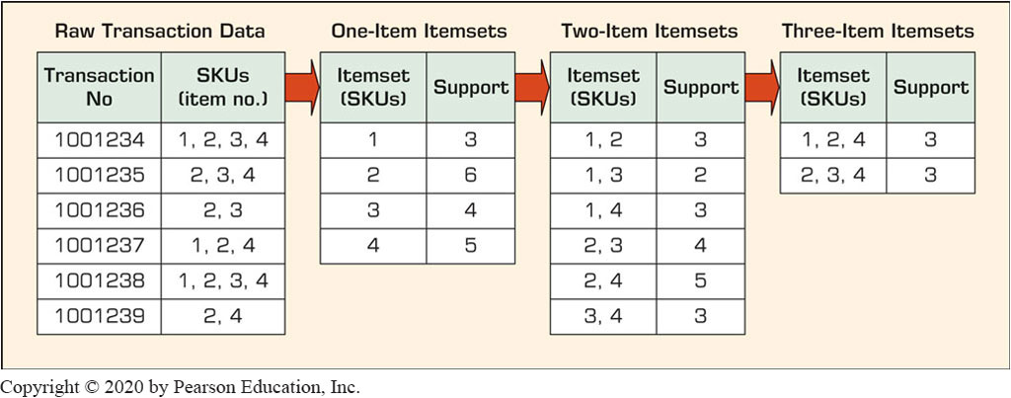
Association Rule Mining Apriori Algorithm
Figure 4.14 A Graphical Illustration of the Steps in the k-Means Algorithm.

Slide 54
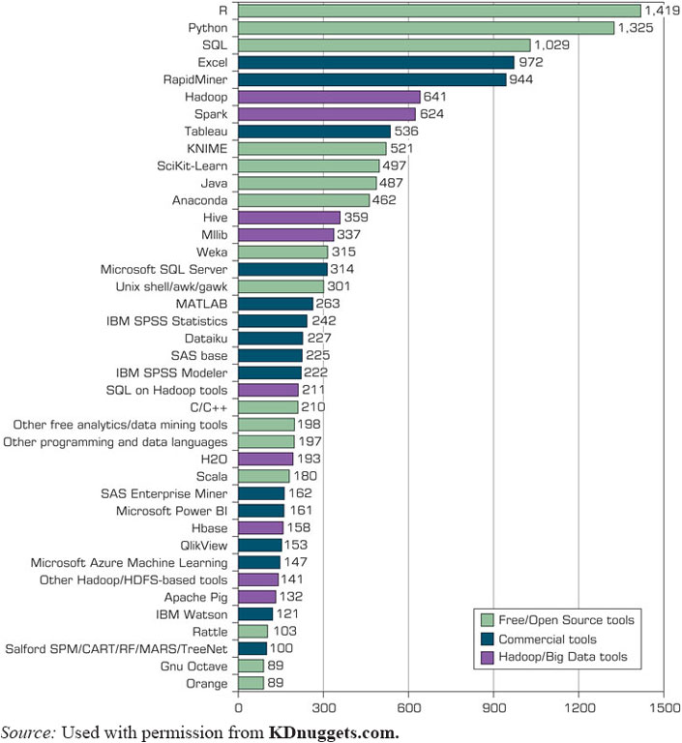
Data Mining Software Tools
Figure 4.15 Popular Data Mining Software Tools (Poll Results).
Commercial
I B M S P S S Modeler (formerly Clementine)
S A S Enterprise Miner
Statistica - Dell/Statsoft
… many more
Free and/or Open Source
K N I M E
RapidMiner
Weka
R, …
Source: Used with permission from KDnuggets.com.

Slide 55
Application Case 4.6 (1 of 4)
Data Mining Goes to Hollywood: Predicting Financial Success of Movies
Goal: Predicting financial success of Hollywood movies before the start of their production process
How: Use of advanced predictive analytics methods.
Results: promising.

Slide 56
Application Case 4.6 (2 of 4)
Data Mining Goes to Hollywood: Predicting Financial Success of Movies
A Typical Classification Problem
Table 4.3 Movie Classification based on Receipts
Class No. | 1 | 2 | 3 | 4 | 5 | 6 | 7 | 8 | 9
Range (in millions of dollars) | >1 (Flop) | >1 <610 | >10 <20 | >20 <640 | >40 <665 | >65 <6100 | >100 <6150 | >150 <6200 | >200 (Blockbuster)
Table 4.4 Summary of Independent Variables
Independent Variable | Number of Values | Possible Values
M P A A Rating | 5 | G, P G, P G-13, R, N R
Competition | 3 | High, medium, low
Star value | 3 | High, medium, low
Genre | 10 | Sci-Fi, Historic Epic Drama, Modern Drama, Politically Related, Thriller, Horror, Comedy, Cartoon, Action, Documentary
Special effects | 3 | High, medium, low
Sequel | 2 | Yes, no
Number of screens | 1 | A positive integer between 1 and 3,876

Slide 57
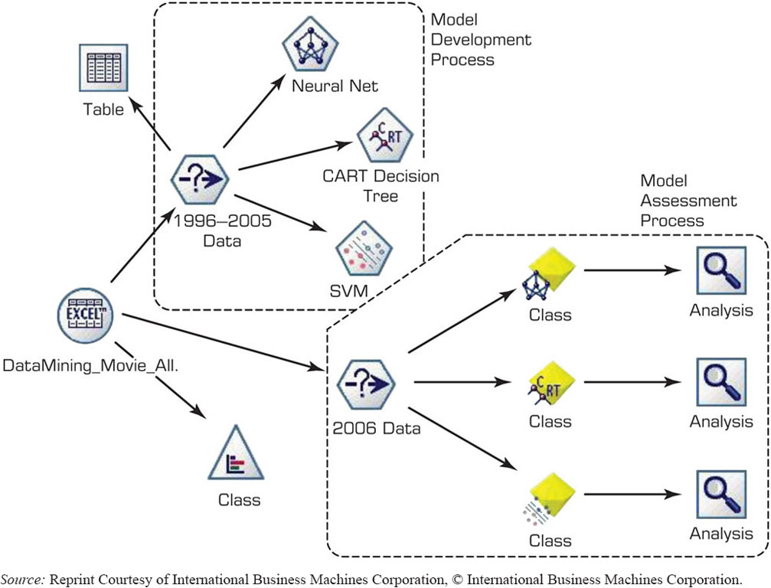
Application Case 4.6 (3 of 4)
Data Mining Goes to Hollywood: Predicting Financial Success of Movies
FIGURE 4.16 Process Flow Screenshot for the Box-Office Prediction System.
The D M Process Map in I B M S P S S Modeler
Source: Reprint Courtesy of International Business Machines Corporation, © International Business Machines Corporation.

Slide 58
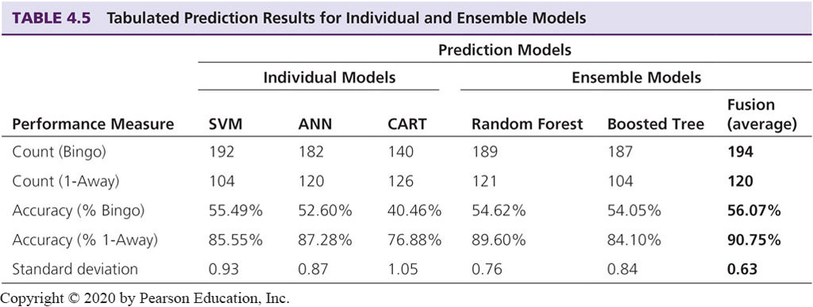
Application Case 4.6 (4 of 4)
Data Mining Goes to Hollywood: Predicting Financial Success of Movies

Slide 59
Data Mining Myths
Table 4.6 Data Mining Myths.
Myth | Reality
Data mining provides instant, crystal-ball-like predictions. | Data mining is a multistep process that requires deliberate, proactive design and use.
Data mining is not yet viable for mainstream business applications. | The current state of the art is ready for almost any business type and/or size.
Data mining requires a separate, dedicated database. | Because of the advances in database technology, a dedicated database is not required.
Only those with advanced degrees can do data mining. | Newer Web-based tools enable managers of all educational levels to do data mining.
Data mining is only for large firms that have lots of customer data. | If the data accurately reflect the business or its customers, any company can use data mining.

Slide 60
Data Mining Mistakes
Selecting the wrong problem for data mining
Ignoring what your sponsor thinks data mining is and what it really can/cannot do
Beginning without the end in mind.
Not leaving insufficient time for data acquisition, selection and preparation
Looking only at aggregated results and not at individual records/predictions
… 10 more mistakes… in your book

Slide 61
Application Case 4.7
Predicting Customer Buying Patterns – The Target Story
Questions for Discussion:
What do you think about data mining and its implication for privacy? What is the threshold between discovery of knowledge and infringement of privacy?
Did Target go too far? Did it do anything illegal? What do you think Target should have done? What do you think Target should do next (quit these types of practices)?

Slide 62
End of Chapter 4
Questions / Comments

Slide 63

Copyright
This work is protected by United States copyright laws and is provided solely for the use of instructors in teaching their courses and assessing student learning. Dissemination or sale of any part of this work (including on the World Wide Web) will destroy the integrity of the work and is not permitted. The work and materials from it should never be made available to students except by instructors using the accompanying text in their classes. All recipients of this work are expected to abide by these restrictions and to honor the intended pedagogical purposes and the needs of other instructors who rely on these materials.

